Slide 1
Liskov Substitution Principle (LSP)
Ref: Barbara Liskov, “Data Abstraction and Hierarchy”, ACM SIGPLAN Notices, 23, 5 (May 1988)

Slide 2
LSP Statement
A base class object should be substitutable with any of its derived class objects…
B
Logger
Logger
Now you require to support creation of Logs on remote machines
D
createLog
createLog
Careless extensions can cause problems…
NetworkLogger
Asks remote machine IP…
Derived class objects should not violate the behavior expected of the base class!

Slide 3
LSP: Statement of Principle
A
Methods using references to a class:
  Must be able to use objects of any class derived from it without knowing the specifics of the derived object.
The base class provides a protocol that clients can use:
  Without regard to the specific derived class responding to the client’s messages.
abstract class Credit {
...
abstract boolean validateCredit( Account a, int amt, CreditCard c);
...
}
B
EduCredit
BizCredit
IndividualCredit
IndianAccount
USAccount
UKAccount
EUAccount
JPAccount
OtherAccount
VISACard
AmExpCard
StoreCard

Slide 4
LSP in Other Words
“An instance of a derived class should be able to replace any instance of its super class.”
In effect, the base class establishes a basic behavior (functionality) that clients know of.
  If a derived class violates the contract, then a violation of LSP occurs.

Slide 5
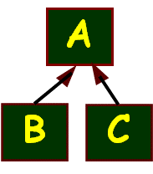
LSP in Plain English…
Any subclass object should always be seamlessly usable in place of its parent class object.
Corollary - All derived classes must honour contracts of their base classes:
  IS A ➔ same public behavior
  Pre-conditions can only get weaker (at most)
  Post-conditions can only get stronger (at least)

Slide 6
Liskov’s Pre- and Post-conditions
Preconditons should not get strengthened in a derived class:
  Precondition is the constraints that the input parameter to a method call should satisfy for the method to run correctly.
  The parameters which work with the supertype, at least that much must work with the subtype
Postconditions should not get weakened in a derived class:
  Post-condition is the constraint that the output result of a method should satisfy in a successful run
  What is guaranteed by the supertype should also be guaranteed by the subtype

Slide 7
Pre conditions can only Get Weaker
Example:
    void drive(car v); //super type
    void drive(Maruti m); //sub type
    void drive(vehicle v); //sub type
✗
✓

Slide 8
Post conditions can only Get Stronger
Example:
    Car create(); //super type
    Vehicle create(); //sub type
    Maruti create(); //sub type
✗
✓

Slide 9
The Square-Rectangle Problem
You thought square is a special type of Rectangle, so it is natural to derive a square from a rectangle…
Rectangle
Clients (users) of Rectangle expect
that setting height leaves width
unchanged (and vice versa)
Square does not fulfill this.
Client algorithms can get confused
Hack: A client attempts to identify subclasses and use if/switch (RTTI) to take specific actions…
height : double
width : double
+ setHeight (: double)
+ setWidth (: double)
Square
+ setHeight (: double)
+ setWidth (: double)
Class Square extends Rectangle{
void setHeight (double h) {
super.setHeight(h);
super.setWidth(h);
}
void setWidth(double w) {
setHeight(w);
}
This creates further problems!
Any problems?

Slide 10
LSP
Implication…
class Square extends Rectangle {
public void setWidth(int width) {
super.setWidth(width);
super.setHeight(width);
}
public void setHeight(int height) {
super.setHeight(height);
super.setWidth(height);
}
}
Class Client{
…
void clientOfRectangle(Rectangle r) {
r.setWidth(10);
r.setHeight(20);
print(r.area());
}
Void test(){
Rectangle r = new Square(…);
clientOfRectangle(r); // what would be printed?}
Rectangle
-int width;
-int height
+getWidth()
+setWidth()
+getHeight()
+setHeight()
+area();
Square
+getWidth()
+setWidth()
+getHeight()
+setHeight()

Slide 11

Where is the Problem?
clientOfRectangle() method made the following reasonable assumption:
  Changing the width of a Rectangle leaves its height unchanged.
Clients of rectangle need to know they are working with a square:
  If they want to take advantage of square’s property: height = width.

Slide 12
LSP: Analysis of the Problem
Deriving a square from a rectangle implies:
  One of the state variables --- height or width is redundant.
Mathematically, a square may be a rectangle:
  But, behaviorally a Square is not a Rectangle!
  The behavior of a Square object is not consistent with the behavior of a Rectangle object!

Slide 13
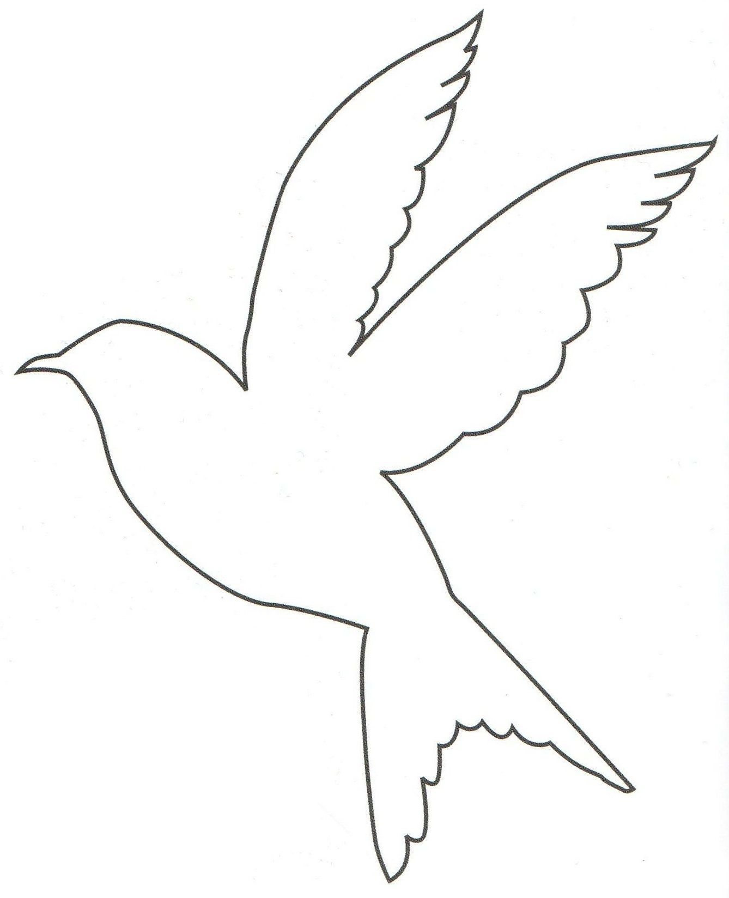

Using Inheritance Appears Simple…
class Bird { // has beak, wings,...
public void fly(); // Bird can fly
};
class Parrot extends Bird { // Parrot is a bird
public void mimic(); // Can Repeat words...
};
// ...
Parrot mypet;
mypet.mimic(); // my pet being a parrot can Mimic()
mypet.fly(); // my pet “is-a” bird, can fly
Bird
OK
Parrot

Slide 14
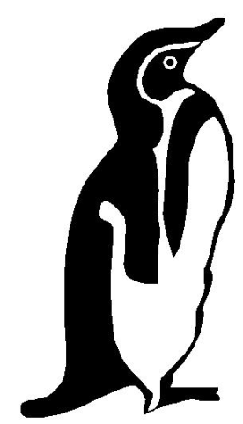
Penguins Fail to Fly!
class Penguin extends Bird {
public void fly() {
error (“Penguins don’t fly!”); }
};
void PlayWithBird (Bird abird) {
abird.fly(); // OK if Parrot.
// if bird happens to be Penguin...OOOPS!!
}
Bird
Penguin
Does not model: “Penguins can’t fly”
It models “Penguins may fly, but if they try it is error”
Run-time error if attempt to fly → not desirable
Check Substitutability - Fails LSP

Slide 15
Analysis of Failure Examples
LSP implies:
  “is-a” relationship is based on behavior, not some intrinsic mental model.
The behavior of a rectangle:
  Change its height and you leave its width unchanged…
  Does not apply to squares and so square objects are not rectangle objects.

Slide 16
Simple Solution: Avoid Concrete Super Classes
All Super classes should be abstract.
  Only leaf classes could be concrete.
Still some would say Why? Let’s see another example…
A class to provide accounts in a bank.
CurrentAccount
+withdrawAmt()
Change required: The bank wants to cater to savings accounts. How would you do that?

Slide 17
Naive Solution…
Concrete superclass
CurrentAccount
+withdrawAmt()
The subclass inherits the shared functionalities
SavingsAccount
+addInterest()

Slide 18
Handling Changes…
CurrentAccount
+withdrawAmt()
Now the bank decides:
  Allow current accounts to become overdrawn…
  but not SavingsAccounts.
    How to do this?
SavingsAccount
+addInterest()

Slide 19
A Possibility…
public class CurrentAccount {
...
void withdraw (double amt) {
if (this instanceof SavingsAccount) {
// check if becoming overdrawn
}
balance -= amt;
}
...
}
Check the type of the account
What are some of the problems with this solution?

Slide 20
A Problem with the Solution
The superclass needs to take care of subclasses!
Public class CurrentAccount {
void withdraw (double amt) {
if (this instanceof SavingsAccount) {
If(becoming overdrawn){
error(“not allowed”); return;}
}
balance -= amt;
}
}
If we add a new subclass, then changes to the base code will be necessary:
…the super class is not closed.

Slide 21
Example of Problems to Come…
Consider adding a few new functionalities.
Example: Unlimited free cheque books in current account:
-- but not on SavingsAccounts.
void issueChequeBook (CurrentAccount a) {
if (a instanceof SavingsAccount)
return;
dispatchChequeBook();
}
What is causing the problems?

Slide 22
The Root of the Problem…
LSP Violation
CurrentAccount
+printChequeBook()
Superclass should only provide an interface that is implemented by all subclasses
Here it is also providing a default implementation…
SavingsAccount
+addInterest()
void issueChequeBook(CurrentAccount a) {
if (a instanceof SavingsAccount)
return;
printChequeBook();
}

Slide 23
General LSP Solution
All super classes should be abstract.
<<abstract>>
Shape
Client
<<abstract>>
Account
<<Uses>>
Rectangle
Square
Savings
Current
Overrides with code that checks if becoming overdrawn

Slide 24
When is LSP of No Concern?
Faculty, Staff, Secretary and Engineer all have the same set of attributes and operations:
  No new types of employees envisioned.
Employee
+printInfo()
generalization
Faculty
+printInfo()
Staff
+printInfo()
Secretary
+printInfo
Engineer
+printInfo()

Slide 25
Summary
The Liskov Substitution Principle (LSP) states:
  Every method call that operates on a base class reference should operate similarly when a derived class object is substituted for the base object.
  In doing this, it should not need to know which specific derived object it is dealing.

